Slide 1

Python for Data Science

Slide 2

What Is NumPy — and Why Does It Matter?
NumPy (Numerical Python) is a Python library for working with arrays — ordered, numbered containers of values, like a row of labeled boxes.
Fast: Written in C, runs up to 50× faster than Python lists
Efficient: Uses less memory by storing only one data type
Universal: Foundation for Pandas, Matplotlib, and scikit-learn
💡 Real-world uses: Image processing, ML models, financial analysis, scientific simulations

Slide 3


NumPy Arrays vs. Python Lists
Lists are flexible but slow. NumPy arrays are fast, memory-efficient, and built for data.
Feature
Python List
NumPy Array
Speed
Slower (interpreted)
Up to 50× faster
Memory
Higher overhead
Compact, uniform
Data Types
Mixed allowed
Single type only
Operations
Loop required
Built-in, vectorized
import numpy as np
import time
lst = list(range(1000000))
arr = np.arange(1000000)
start = time.time()
[x * 2 for x in lst]
print("List:", time.time() - start)
start = time.time()
arr * 2
print("Array:", time.time() - start)
⚡ Output: List ~0.15s · Array ~0.003s — NumPy wins!

Slide 4

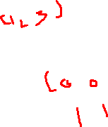
Five Ways to Create Arrays
1
np.array()
Convert any list into an array
2
np.zeros()
Array of all zeros — great for initialization
3
np.ones()
Array of all ones — useful for scaling
4
np.arange()
Like Python's range() — sequential integers
5
np.linspace()
Evenly spaced numbers over a range
import numpy as np
a = np.array([1, 2, 3, 4, 5])
b = np.zeros(3)
c = np.ones((2, 2))
d = np.arange(0, 10, 2)
e = np.linspace(0, 1, 5)
print(a)
print(b)
print(c)
print(d)
print(e)
Expected Output
[1 2 3 4 5]
[0. 0. 0.]
[[1. 1.]
[1. 1.]]
[0 2 4 6 8]
[0. 0.25 0.5 0.75 1. ]
🔑 Memory trick: Zeros = empty start · Ones = full start · Arange = step-by-step · Linspace = smooth spread

Slide 5


Array Attributes & Dimensions
Every array has built-in properties that describe its shape, size, and data type.
arr = np.array([[1, 2, 3],
[4, 5, 6]])
print(arr.shape) # (2, 3) → 2 rows, 3 cols
print(arr.ndim) # 2 → two-dimensional
print(arr.size) # 6 → total elements
print(arr.dtype) # int64 → data type
.shape
(rows, cols)
.ndim
# of axes
.size
Total items
.dtype
Data type

Slide 6
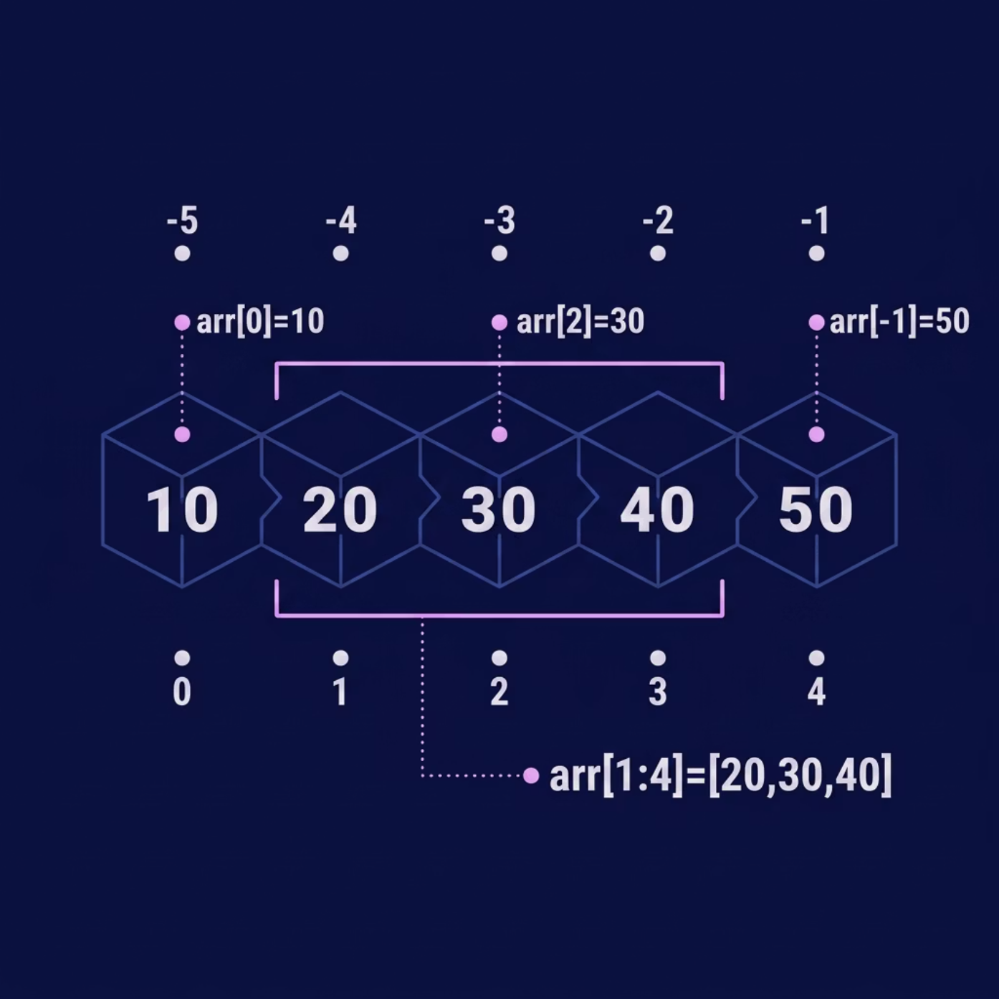


Indexing & Slicing Arrays
Indexing — Pick One Element
arr = np.array([10, 20, 30, 40, 50])
print(arr[0]) # 10 → first
print(arr[-1]) # 50 → last
print(arr[2]) # 30 → third
arr2d = np.array([[1,2,3],
[4,5,6]])
print(arr2d[1, 2]) # 6 → row 1, col 2
Slicing — Pick a Range
print(arr[1:4]) # [20 30 40]
print(arr[::2]) # [10 30 50] → every 2nd
print(arr[::-1]) # [50 40 30 20 10] → reverse
⚠️ Common mistake: arr[5] on a 5-element array → IndexError! Last index is always size - 1.

Slide 7


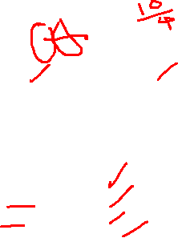
Array Operations & Broadcasting
Element-wise Math
Broadcasting — Different Shapes Together
a = np.array([1, 2, 3, 4])
b = np.array([10, 20, 30, 40])
print(a + b) # [11 22 33 44]
print(a * 10) # [10 20 30 40]
print(b ** 0.5) # [3.16 4.47 5.48 6.32]
arr = np.array([[1, 2, 3],
[4, 5, 6]])
print(arr + 100)
# [[101 102 103]
# [104 105 106]]
Aggregation Functions
📡 Broadcasting rule: NumPy "stretches" the smaller value to match — no loops needed!
print(np.sum(a)) # 10
print(np.mean(a)) # 2.5
print(np.min(b)) # 10
print(np.max(b)) # 40
print(np.std(a)) # 1.118 → spread
📊 axis=0 → down columns · axis=1 → across rows

Slide 8



Reshaping, Stacking & the Random Module
Reshape & Stack
arr = np.arange(1, 7) # [1 2 3 4 5 6]
reshaped = arr.reshape(2, 3)
# [[1 2 3]
# [4 5 6]]
a = np.array([1, 2, 3])
b = np.array([4, 5, 6])
print(np.vstack([a, b])) # stack rows
print(np.hstack([a, b])) # stack cols → [1 2 3 4 5 6]
Random Data Generation
np.random.seed(42) # reproducible
print(np.random.rand(3)) # 0–1 floats
print(np.random.randint(1, 100, 5)) # integers
print(np.random.randn(3)) # normal dist.
⚠️ Reshape rule: Total elements must match! 6 ≠ 2×4 → ValueError

Slide 9

Aggregation Functions: Summarizing Your Data
Aggregation functions condense array data into a single descriptive value, offering quick insights into its characteristics. They are essential for statistical analysis and data summarization.
np.sum()
np.mean()
Calculates the total sum of all elements in the array.
Determines the average (mean) value of the array elements.
np.max()
np.min()
Identifies the largest element within the array.
Finds the smallest element present in the array.
np.std()
np.var()
Measures the standard deviation, indicating data spread around the mean.
Computes the variance, the average of squared differences from the mean.
import numpy as np
data = np.array([10, 20, 30, 40, 50])
print(f"Sum: {np.sum(data)}")
print(f"Mean: {np.mean(data)}")
print(f"Min: {np.min(data)}")
print(f"Max: {np.max(data)}")
print(f"Std Dev: {np.std(data):.2f}")
print(f"Variance: {np.var(data):.2f}")
Output
Sum: 150
Mean: 30.0
Min: 10
Max: 50
Std Dev: 14.14
Variance: 200.00
Axis Awareness: These functions can also operate along specific axes (rows or columns) for multi-dimensional arrays, using the axis parameter.

Slide 10
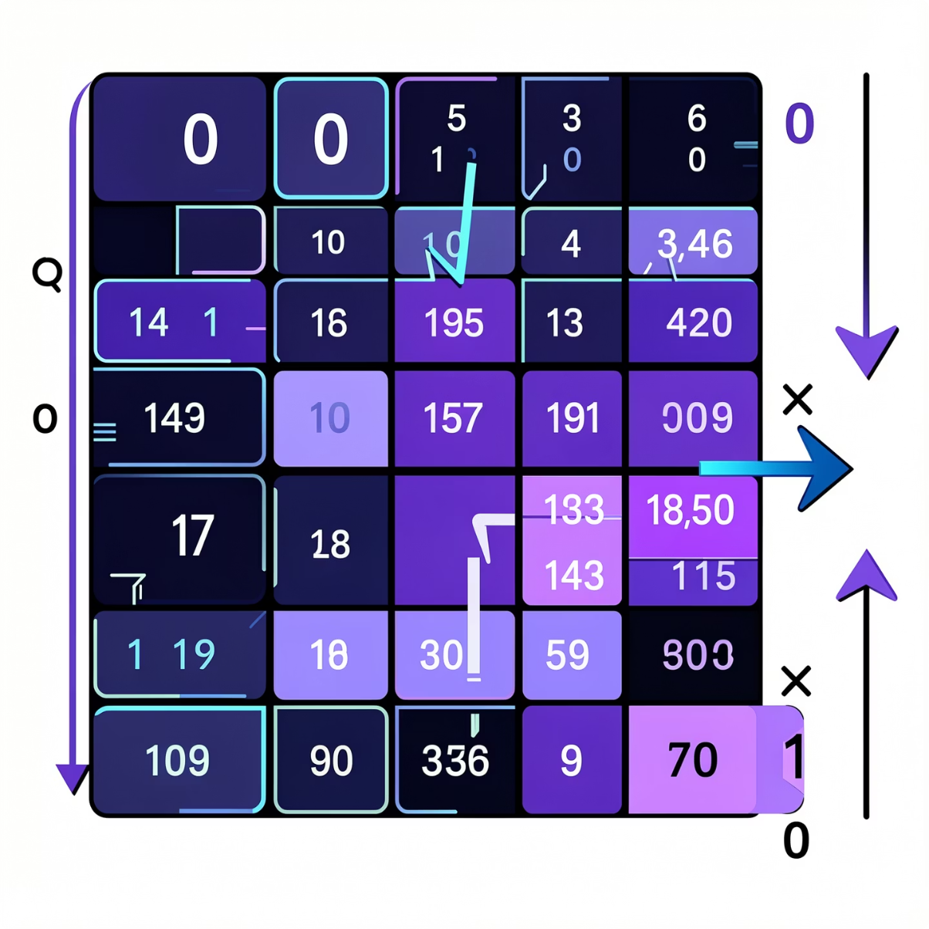

Axis-wise Operations
Understanding the axis parameter is crucial for performing operations along specific dimensions of your NumPy arrays. It defines the direction of computation.
axis=0
Perform operations vertically, column by column. The result will have a dimension corresponding to the number of columns.
axis=1
Perform operations horizontally, row by row. The result will have a dimension corresponding to the number of rows.
Let's see how this works with the sum() function on a 2D array:
Expected Output
import numpy as np
matrix = np.array([[1, 2, 3],
[4, 5, 6],
[7, 8, 9]])
print("Matrix:\n", matrix)
print("\nSum along axis=0 (columns):")
print(np.sum(matrix, axis=0))
print("\nSum along axis=1 (rows):")
print(np.sum(matrix, axis=1))
Matrix:
[[1 2 3]
[4 5 6]
[7 8 9]]
Sum along axis=0 (columns):
[12 15 18]
Sum along axis=1 (rows):
[ 6 15 24]
💡 Think of axis=0 as collapsing rows into a single row (summing downwards), and axis=1 as collapsing columns into a single column (summing across).

Slide 11

Matrix Operations
NumPy provides powerful functions for essential matrix operations, crucial for linear algebra, data transformations, and machine learning algorithms. Understanding these functions—dot(), matmul(), and transpose()—is key to effective numerical computing.
np.dot() vs. np.matmul()
np.dot() performs multiplication between vectors or matrices.
It is used for:
Vector multiplication
Matrix multiplication
Mathematical computations in ML
Both perform matrix multiplication, but np.matmul() (or the @ operator) follows standard linear algebra rules, handling broadcasting more intuitively for multi-dimensional arrays. np.dot() has broader functionality, including scalar and vector dot products.
np.transpose()
The transpose of a matrix flips it over its diagonal, switching the row and column indices of the matrix. This is a common operation for aligning dimensions in matrix multiplication or reshaping data.
np.dot() Example:
Vector Dot Product
import numpy as np
a = np.array([1, 2])
b = np.array([3, 4])
result = np.dot(a, b)
print(result)
Output:11
Matrix Multiplication
import numpy as np
a = np.array([
[1, 2],
[3, 4]
])
b = np.array([
[5, 6],
[7, 8]
])
result = np.dot(a, b)
print(result)
Output:
[[19 22]
[43 50]]
np.matmul() Example:
import numpy as np
a = np.array([
[1, 2],
[3, 4]
])
b = np.array([
[5, 6],
[7, 8]
])
result = np.matmul(a, b)
print(result)
Output:
[[19 22]
[43 50]]
import numpy as np
matrix = np.array([
[1, 2, 3],
[4, 5, 6]
])
transposed = np.transpose(matrix)
print(transposed)
Output:
[[1 4]
[2 5]
[3 6]]
💡 Real-world applications: Matrix operations are fundamental in fields like
image processing (filters, transformations), machine learning (neural networks, linear regression),
physics (transforming coordinate systems), and computer graphics (3D rendering).

Slide 12


Reshaping Arrays: Deeper Dive
NumPy provides versatile methods to change an array's dimensions without altering its underlying data. Mastering reshape(), flatten(), and ravel() is key for preparing data in various analytical contexts.
np.reshape()
np.flatten()
np.ravel()
Returns an array with the same data but a new shape. The new shape must be compatible with the original number of elements.
Always returns a copy of the array collapsed into a 1D array. Changes to the flattened array do not affect the original.
Returns a view of the array (if possible) collapsed into a 1D array. Changes to the raveled array might affect the original.
matrix = np.array([[1, 2], [3, 4]])
flat_copy = matrix.flatten()
# [1 2 3 4]
flat_copy[0] = 99
# matrix remains unchanged
matrix = np.array([[1, 2], [3, 4]])
raveled_view = matrix.ravel()
# [1 2 3 4]
raveled_view[0] = 99
# matrix will be updated: [[99 2] [3 4]]
arr = np.arange(1, 7)
# [1 2 3 4 5 6]
reshaped = arr.reshape(2, 3)
# [[1 2 3]
# [4 5 6]]
⚠️ For ravel(), be cautious with modifications if you intend to preserve the original array, as it often returns a view.

Slide 13
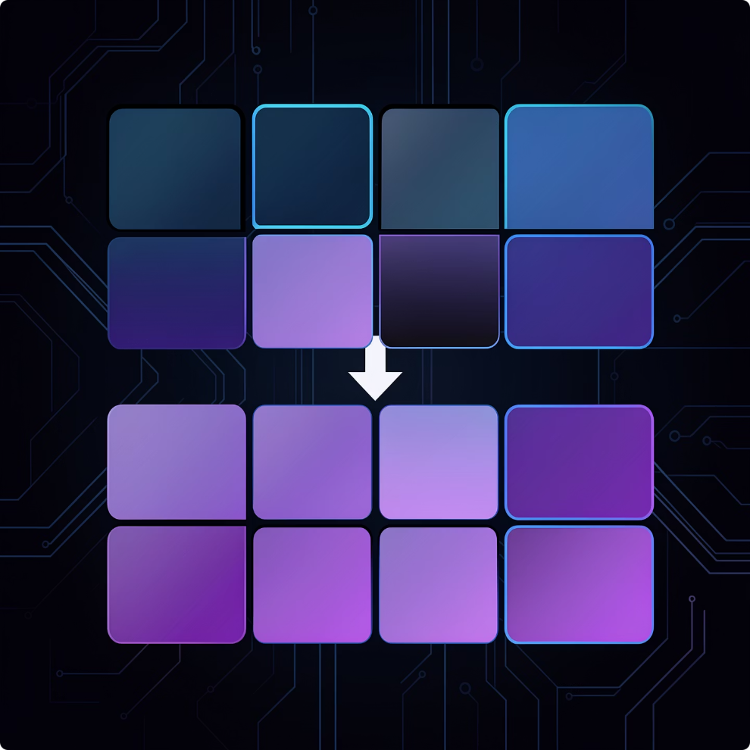

Stacking Arrays
NumPy offers powerful functions to combine arrays, enabling you to build larger, more complex data structures from smaller ones. This process, known as stacking, is fundamental for organizing and preparing data for analysis, especially when dealing with multiple datasets or dimensions.
Vertical Stacking
Horizontal Stacking
General Concatenation
Stacks arrays vertically (row-wise), adding rows to the existing structure. All input arrays must have the same number of columns.
Stacks arrays horizontally (column-wise), adding columns. All input arrays must have the same number of rows.
A more versatile function for joining arrays along an existing axis. Requires consistent array shapes along the chosen axis.
np.vstack(): Vertical Stacking
Used to stack arrays in sequence vertically (row-wise). This is equivalent to concatenation along the first axis after 1-D arrays of shape (N,) have been reshaped to (1,N).
import numpy as np
arr1 = np.array([1, 2, 3])
arr2 = np.array([4, 5, 6])
arr3 = np.array([[7, 8, 9]])
# Stacking 1D arrays
stacked_1d = np.vstack((arr1, arr2))
print("Vertically stacked 1D arrays:\n", stacked_1d)
# Stacking with a 2D array
stacked_mixed = np.vstack((arr1, arr3))
print("\nVertically stacked 1D and 2D:\n", stacked_mixed)
Output
Vertically stacked 1D arrays:
[[1 2 3]
[4 5 6]]
Vertically stacked 1D and 2D:
[[1 2 3]
[7 8 9]]

Slide 14

np.hstack(): Horizontal Stacking
Used to stack arrays in sequence horizontally (column-wise). This is equivalent to concatenation along the second axis, except for 1-D arrays which are first reshaped to a 2D column vector.
import numpy as np
arr1 = np.array([1, 2, 3])
arr2 = np.array([4, 5, 6])
arr3 = np.array([[7], [8], [9]]) # A 3x1 2D array
# Stacking 1D arrays
stacked_1d = np.hstack((arr1, arr2))
print("Horizontally stacked 1D arrays:\n", stacked_1d)
# Stacking with a 2D array
stacked_mixed = np.hstack((arr1.reshape(-1, 1), arr3)) # Reshape arr1 to a column
print("\nHorizontally stacked 1D (reshaped) and 2D:\n", stacked_mixed)
Output
Horizontally stacked 1D arrays:
[1 2 3 4 5 6]
Horizontally stacked 1D (reshaped) and 2D:
[[1 7]
[2 8]
[3 9]]
np.concatenate(): General Concatenation
The most flexible stacking function, allowing you to specify the axis along which to join the arrays. All input arrays must have the same shape, except for the dimension along the concatenation axis.
import numpy as np
matrix1 = np.array([[1, 2], [3, 4]])
matrix2 = np.array([[5, 6], [7, 8]])
# Concatenate along axis=0 (rows)
concat_rows = np.concatenate((matrix1, matrix2), axis=0)
print("Concatenated along axis=0:\n", concat_rows)
# Concatenate along axis=1 (columns)
concat_cols = np.concatenate((matrix1, matrix2), axis=1)
print("\nConcatenated along axis=1:\n", concat_cols)
# Shape compatibility requirement:
# If concatenating along axis=0, number of columns must match.
# If concatenating along axis=1, number of rows must match.
Output
Concatenated along axis=0:
[[1 2]
[3 4]
[5 6]
[7 8]]
Concatenated along axis=1:
[[1 2 5 6]
[3 4 7 8]]
💡 Shape Compatibility: For np.concatenate(), all input arrays must have identical shapes along all dimensions except for the axis you are concatenating along.

Slide 15


Sorting and Searching Arrays
NumPy provides efficient functions to order array elements and locate specific values, crucial for data analysis and preparation tasks.
np.sort()
np.argsort()
np.where()
Returns a sorted copy of an array. You can specify the axis for sorting multi-dimensional arrays.
Returns the indices that would sort an array. This is useful for sorting related arrays based on one.
Returns elements selected from x or y based on a boolean condition. It acts like an array-wise ternary operator.
arr = np.array([3, 1, 4, 1, 5, 9])
sorted_arr = np.sort(arr)
# [1 1 3 4 5 9]
arr = np.array([3, 1, 4, 1, 5, 9])
indices = np.argsort(arr)
# [1 3 0 2 4 5] (indices of sorted elements)
arr = np.array([10, 20, 30, 40])
result = np.where(arr > 25, 'High', 'Low')
# ['Low' 'Low' 'High' 'High']
Searching Values in Arrays
Beyond conditional selection, you can directly search for specific values or patterns using boolean indexing or functions like np.argwhere() to get coordinates.
Using boolean indexing:
Using np.argwhere() to get indices:
data = np.array([[1, 2, 3],
[4, 5, 6],
[7, 8, 9]])
# Find values greater than 5
greater_than_5 = data[data > 5]
# [6 7 8 9]
data = np.array([[1, 2, 3],
[4, 5, 6],
[7, 8, 9]])
# Get coordinates where value is 5
indices_of_5 = np.argwhere(data == 5)
# [[1 1]] (row, column)
💡 Real-world application: In a dataset of customer reviews, np.where() can categorize sentiment (e.g., "Positive" if score > 3), while np.argsort() can rank products by average rating. Searching helps quickly identify specific problematic reviews or high-performing products.

Slide 16

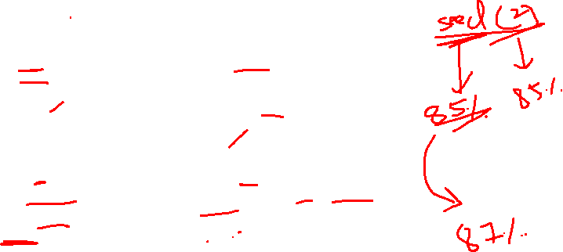
The NumPy Random Module
The numpy.random module is essential for generating arrays of random numbers, which is crucial for simulations, statistical modeling, and machine learning tasks. It provides various functions to create random data from different distributions.
np.random.rand()
np.random.randint()
Generates random floats in the half-open interval [0.0, 1.0). Useful for uniform distributions.
Generates random integers from low (inclusive) to high (exclusive). Specify size for shape.
np.random.rand(2, 3)
# [[0.1, 0.5, 0.9],
# [0.2, 0.7, 0.4]]
np.random.randint(1, 10, size=(2, 2))
# [[3, 8],
# [1, 5]]
np.random.randn()
np.random.seed()
Returns samples from the "standard normal" (Gaussian) distribution. Mean 0 and variance 1.
Seeds the pseudo-random number generator, ensuring reproducible results. Essential for debugging and consistent experiments.
np.random.randn(2, 2)
# [[-0.4, 1.2],
# [ 0.6, -0.9]]
np.random.seed(42)
np.random.rand() # Same every time
Random data generation is foundational for tasks like creating synthetic datasets, initializing neural network weights in Machine Learning, or shuffling data for cross-validation. Using np.random.seed() ensures that your experiments are repeatable, a critical aspect of scientific research and model development.

Slide 17



Loading Data with NumPy
Efficiently loading data from external sources, especially CSV files, is a fundamental step in any data science workflow. NumPy provides powerful functions to read and parse tabular data, handling various formats and complexities like missing values.
np.loadtxt(): Simple & Fast
np.genfromtxt(): Robust & Flexible
Ideal for clean, homogeneous data files where all values are of the same type and no missing data is present. It's generally faster for straightforward cases.
A more advanced and robust function designed to handle diverse data files, especially those with missing or heterogeneous data. It's built for real-world messy datasets.
Reads text files line by line.
Automatically detects data types (integers, floats).
Supports custom delimiters (e.g., delimiter=',' for CSV).
Can skiprows (e.g., for headers).
❌ Cannot directly handle missing values (raises error).
Handles missing values (missing_values, filling_values).
Can parse different data types for different columns (dtype=None or dict).
More memory intensive and slower for very large, clean files compared to loadtxt.
Provides more control over parsing behavior.
import numpy as np
# Example: messy.csv contains:
# A,B,C
# 1,2,NaN
# 4,,6
data = np.genfromtxt('messy.csv', delimiter=',',
skip_header=1, missing_values='',
filling_values=0) # Fills missing with 0
# Output:
# [[1. 2. 0.]
# [4. 0. 6.]]
import numpy as np
# Example: data.csv contains:
# 1,2,3
# 4,5,6
data = np.loadtxt('data.csv', delimiter=',')
# Output:
# [[1. 2. 3.]
# [4. 5. 6.]]
💡 Choosing the Right Tool: For clean, uniform data (e.g., numerical scientific datasets), np.loadtxt() is efficient. For real-world datasets with headers, mixed types, or missing values (common in CSVs), np.genfromtxt() is the go-to choice due to its flexibility.

Slide 18

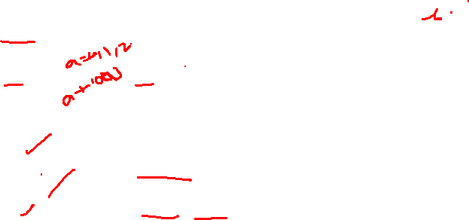
NumPy Cheat Sheet: Essential Commands
This cheat sheet provides a quick reference to the most critical NumPy concepts and functions covered in this presentation, designed for rapid recall during your data science tasks.
Category
Key Concepts/Functions
Description
Core Arrays
np.array(), np.zeros(), np.ones(), np.arange(), np.linspace()
Create N-dimensional arrays; foundation of NumPy. Optimized for numerical operations.
Array Properties
.shape, .ndim, .size, .dtype
Access dimensions, number of axes, total elements, and data type of an array.
Accessing Data
Indexing, Slicing, Boolean Indexing
Select specific elements, ranges, or subsets based on conditions.
Operations
Element-wise ops (+, -, *, /), Broadcasting, np.dot(), .T
Perform arithmetic on arrays, handle different shapes (broadcasting), and execute matrix multiplication/transpose.
Reshaping & Stacking
.reshape(), np.concatenate(), np.vstack(), np.hstack()
Change array dimensions or combine multiple arrays into one.
Aggregation
np.sum(), np.mean(), np.max(), np.min(), np.std()
Summarize data across the entire array or along specific axes.
Sorting & Searching
np.sort(), np.argsort(), np.where(), np.argwhere()
Order array elements, get indices for sorting, or find elements based on conditions.
Random Module
np.random.rand(), np.random.randint(), np.random.randn(), np.random.seed()
Generate random numbers from various distributions; ensure reproducibility.
Data I/O
np.loadtxt(), np.genfromtxt()
Load data from text files (e.g., CSV), handling clean or messy data respectively.
💡 Quick Tip: Use this sheet as a starting point. Experiment with these functions regularly to build muscle memory and deepen your understanding of NumPy.

Slide 19

NumPy Cheat Sheet & Interview Prep
📋 Quick Reference
🎯 Interview Questions
Task
Code
1
Why is NumPy faster than lists?
Create array
np.array([1,2,3])
C-based, contiguous memory, single dtype
Zeros / Ones
np.zeros(3), np.ones(3)
2
What is broadcasting?
Range
np.arange(0,10,2)
NumPy auto-stretches smaller arrays for math ops
Reshape
arr.reshape(2,3)
3
Difference: flatten() vs ravel()?
Stats
np.mean(), np.std()
flatten() = copy · ravel() = view
Random
np.random.rand()
🚀 Next: Pandas → Matplotlib → scikit-learn

